Slide 1


We Plan for You!
Lake County Emergency Management Agency

Slide 2
Our Mission
The Lake County Emergency Management Agency (EMA) will protect Lake County communities by coordinating and integrating all activities necessary to build, sustain, and improve the capability to mitigate against, prepare for, respond to, and recover from threatened or actual natural disasters, acts of terrorism, or other man-made disasters.

Slide 3
About Us
Established under Chapter 5502 of the Ohio Revised Code
The primary focus of the agency, when not in a response or recovery mode, is to ensure that Lake County, along with its more than 230,000 residents, is prepared for an emergency or disaster and to lead the mitigation efforts against the future disaster.
This a tiered effort beginning at the local level!
If the incident overwhelms local resources, or effects multiple political subdivisions within the county, it can become a county incident and the Lake County Commissioners, under the advisement of the EMA Director can declare an emergency and request assistance from the State of Ohio. If the disaster exceeds the capability of the State, aid can be requested from FEMA.

Slide 4
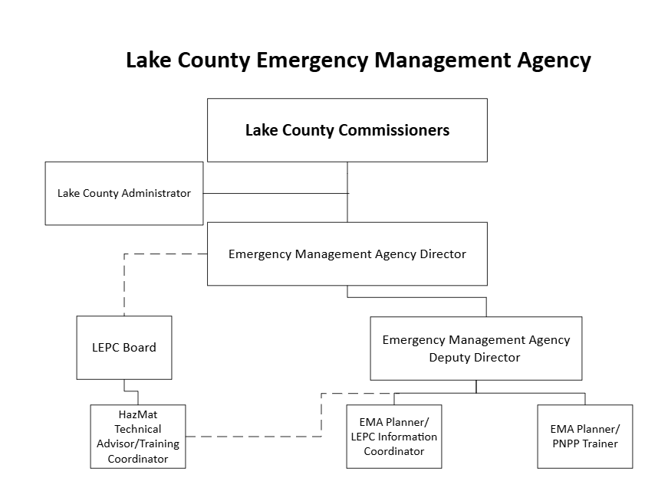

Slide 5
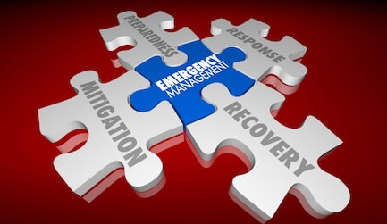
Phases of Emergency Management
Mitigation
Preparedness
Response
Recovery

Slide 6
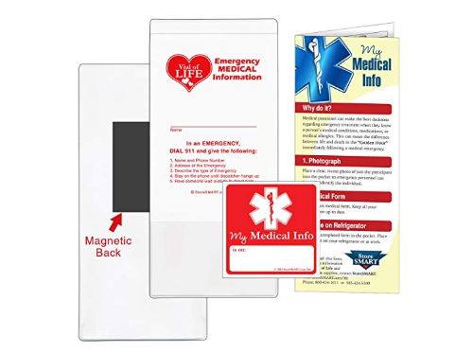
Mitigation
Examples of Mitigation:
Generators
Vial of Life - Medication lists
Managing vegetation
Enforcing building codes
Activities undertaken to avoid, eliminate or reduce the probability of occurrence, or to lessen the effects of an emergency/disaster.
Mitigation involves actions to protect lives and property and to defend against attacks.

Slide 7
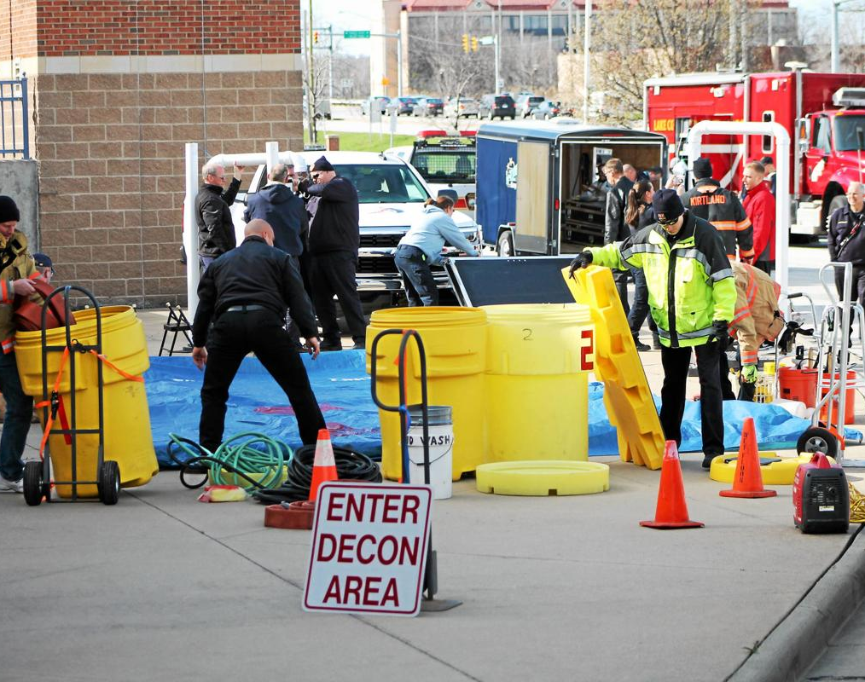
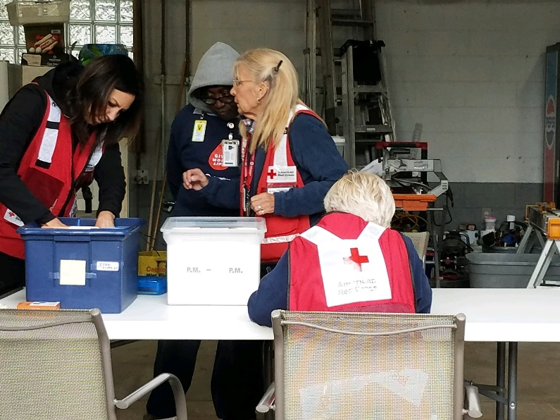
Preparedness
Full Scale Decontamination Exercise
Activities undertaken to prepare for disaster and emergencies and facilitate future response and recovery efforts.
Includes writing emergency operations plans and procedures, training, exercises, evacuation planning, public education and warning.
Red Cross Care Center staff during a full scale exercise

Slide 8
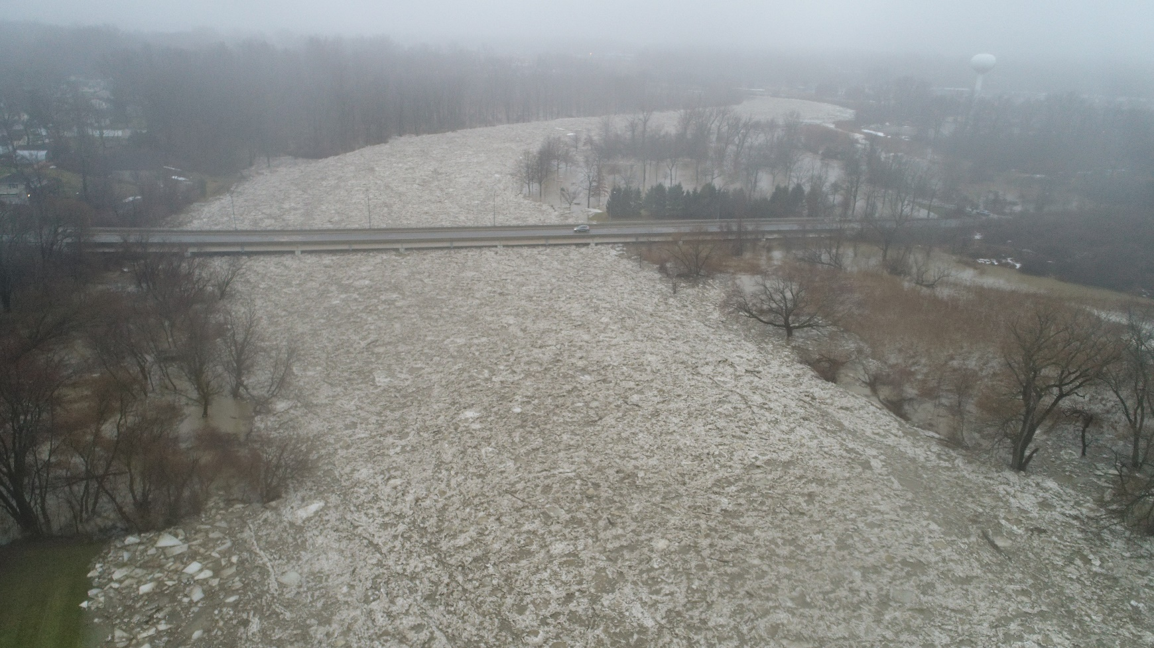
Response (Lights and Sirens)
2025 Ice jam in the Grand River
Activities undertaken in the immediate aftermath of a disaster that help to reduce causalities and damage, and that expedite recovery.
Response activities include warning, evacuation, rescue and other similar operations.

Slide 9
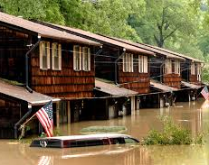

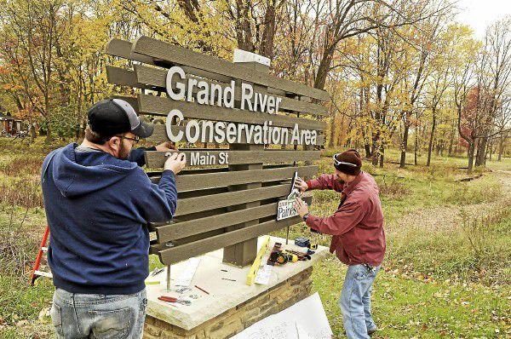
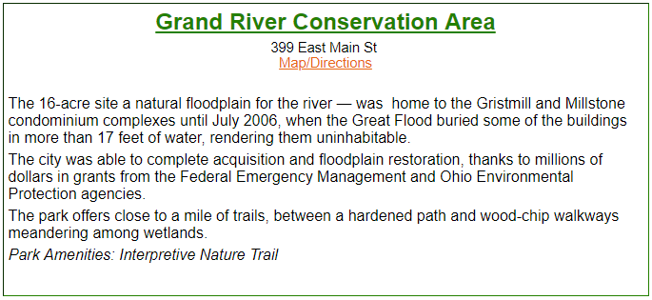
Recovery
Recovery from disasters are short- and long-term actions taken by disaster survivors and governmental entities to rebuild communities.
Actions include helping disaster survivors return to permanent housing and replace essential personal property, reconstruction of infrastructure, community redevelopment activities and long-term redevelopment planning.

Slide 10

Continuity of Operations Planning (COOP)
Purpose: To maintain essential services and functions, despite potential disruptions after your emergency.
Scope: COOP planning addresses all-hazards, including natural disasters, man-made incidents, and technological failures
Who Needs COOP? We all do Federal -State -Local & Private Sectors

Slide 11


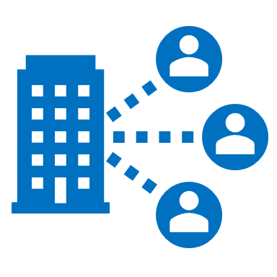

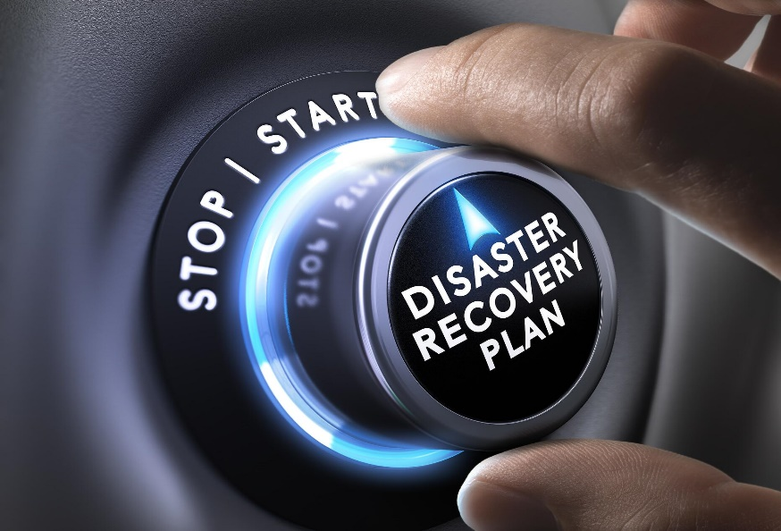

Readiness and Preparedness: Developing the plan and training personnel. Activation and Relocation: Implementing the plan and moving to the alternate facility. Continuity Facility Operations: Maintaining operations at the alternate location. Reconstitution: Returning to normal operations.
Benefits
Improved response to emergencies
Enhanced communication and coordination
Better protection of essential functions

Slide 12
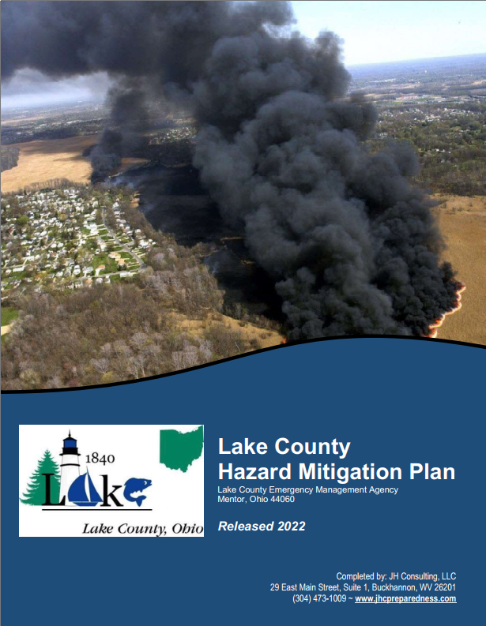
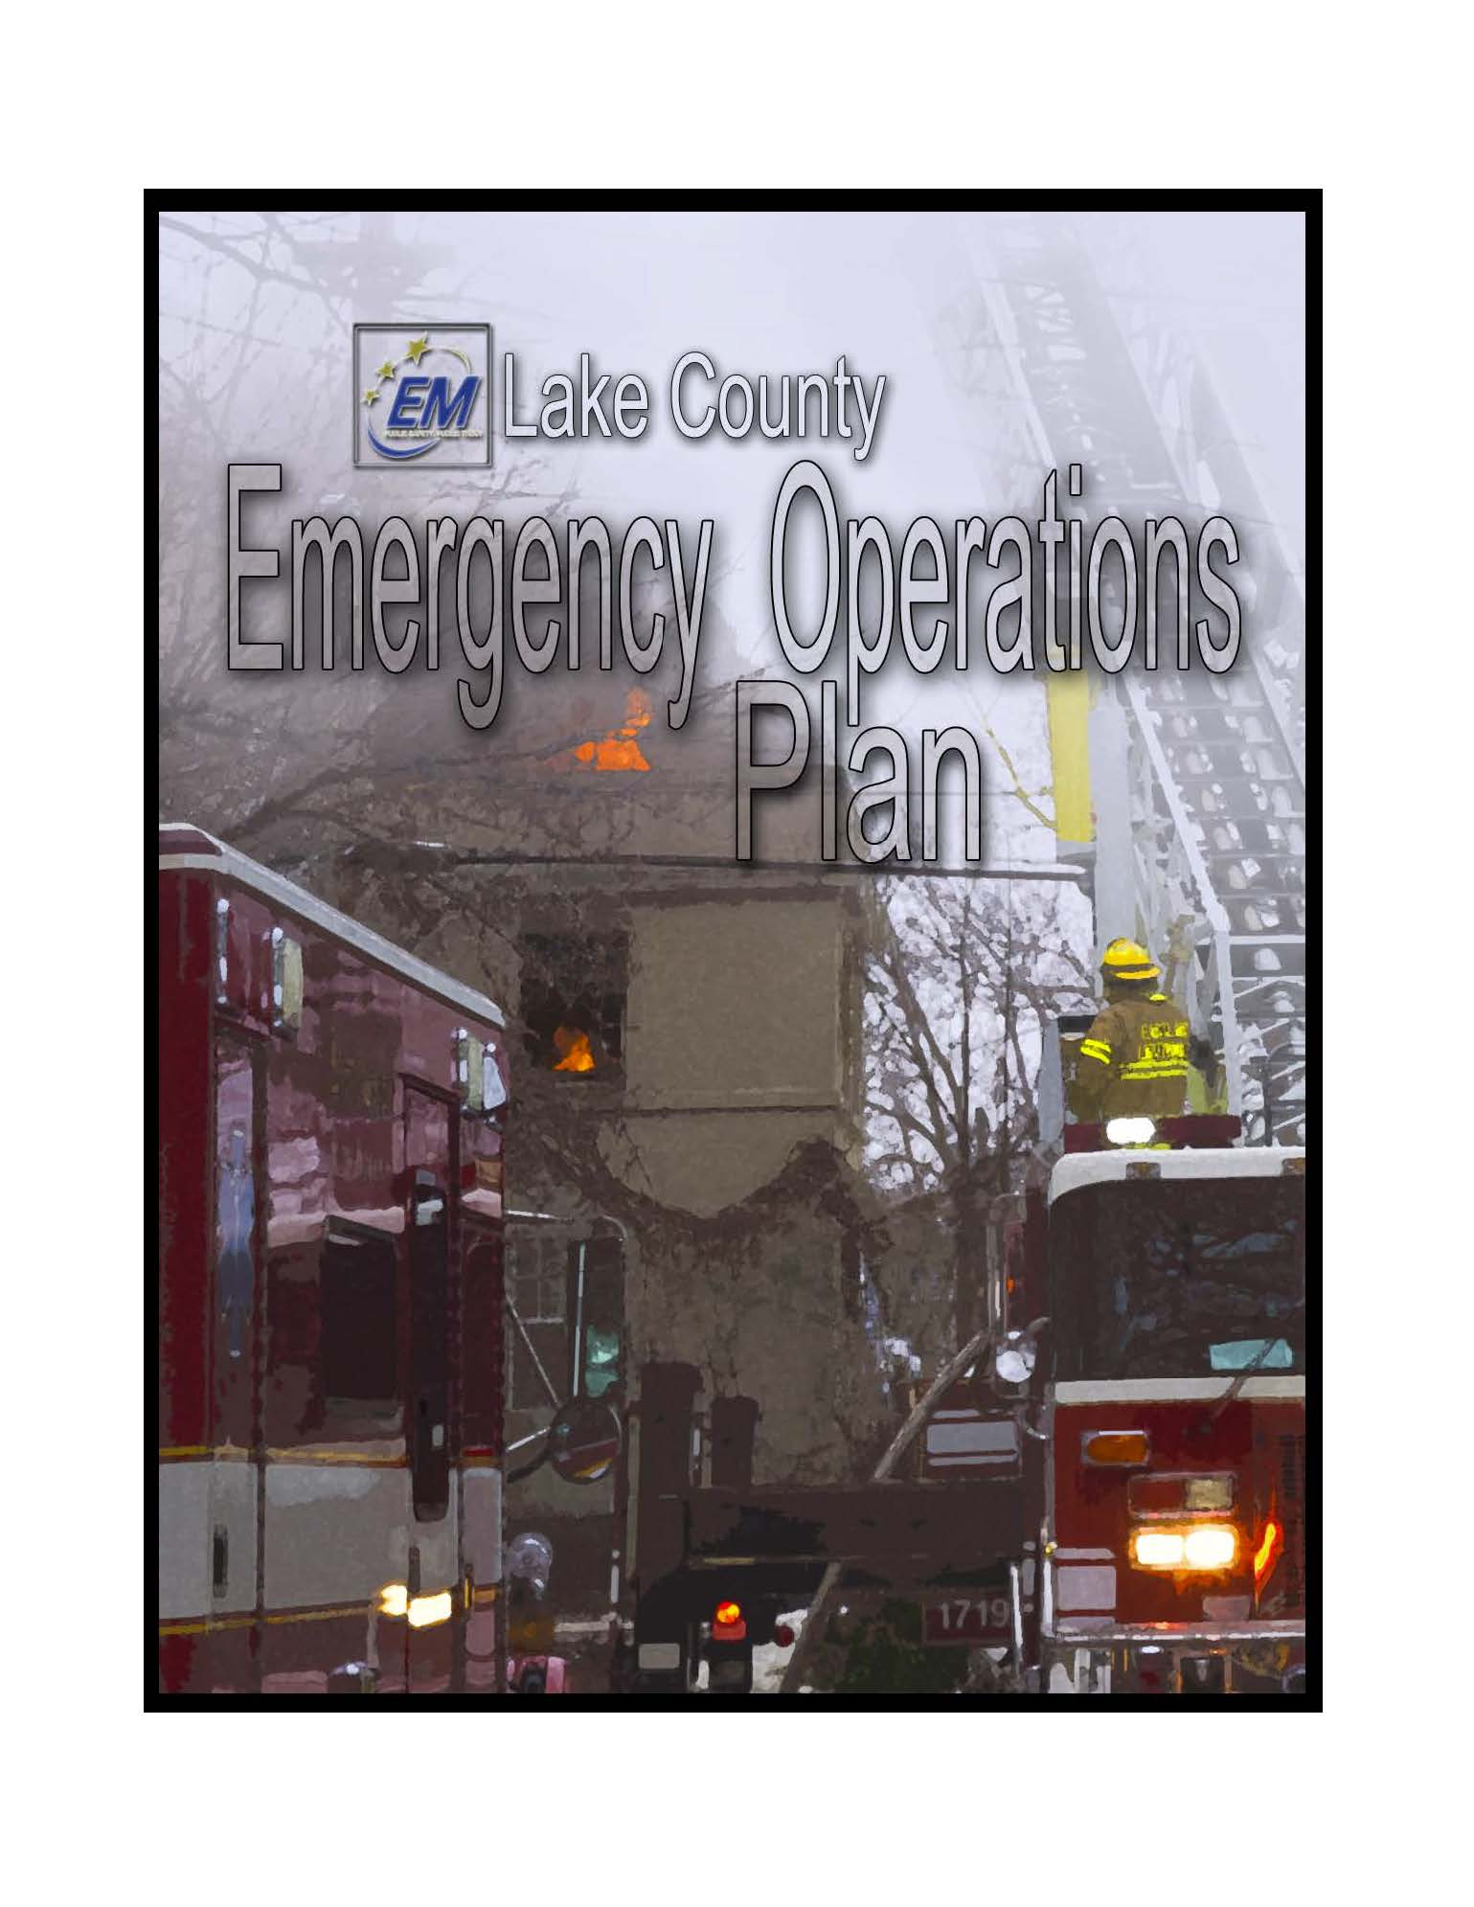
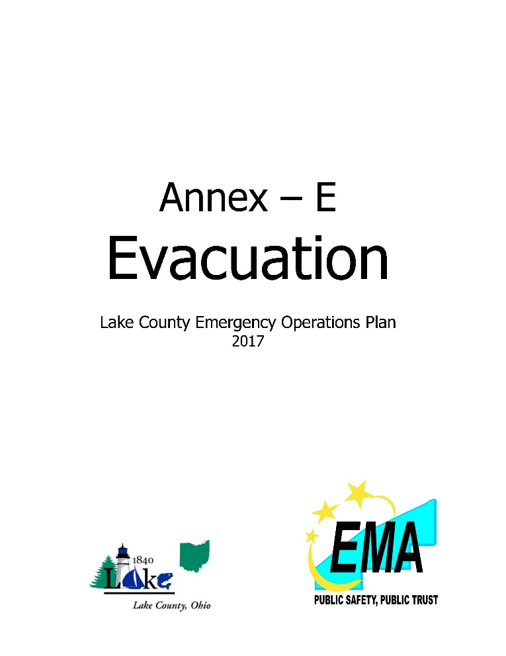
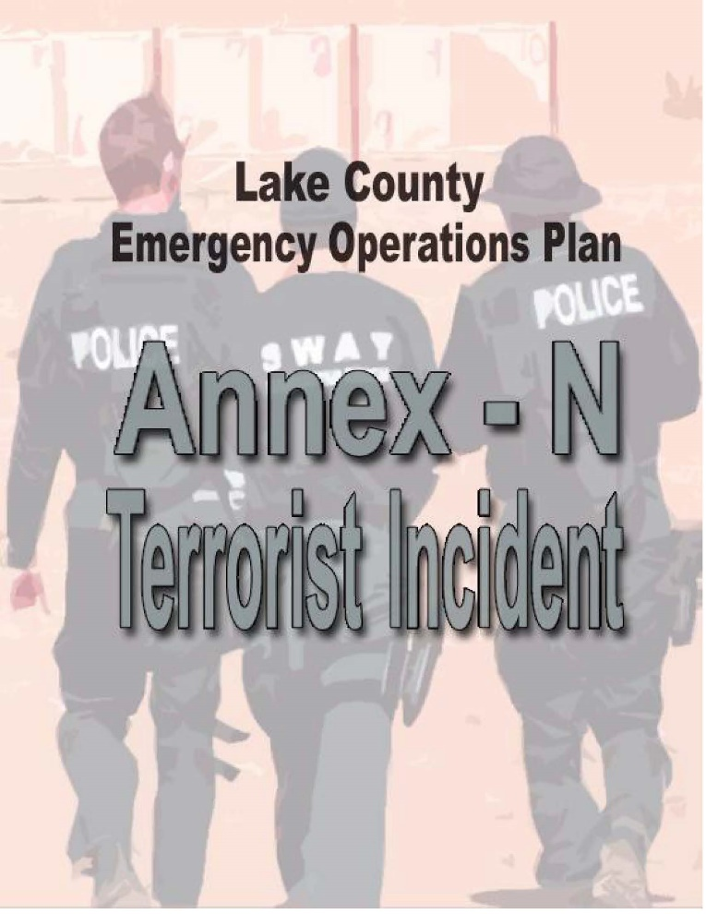
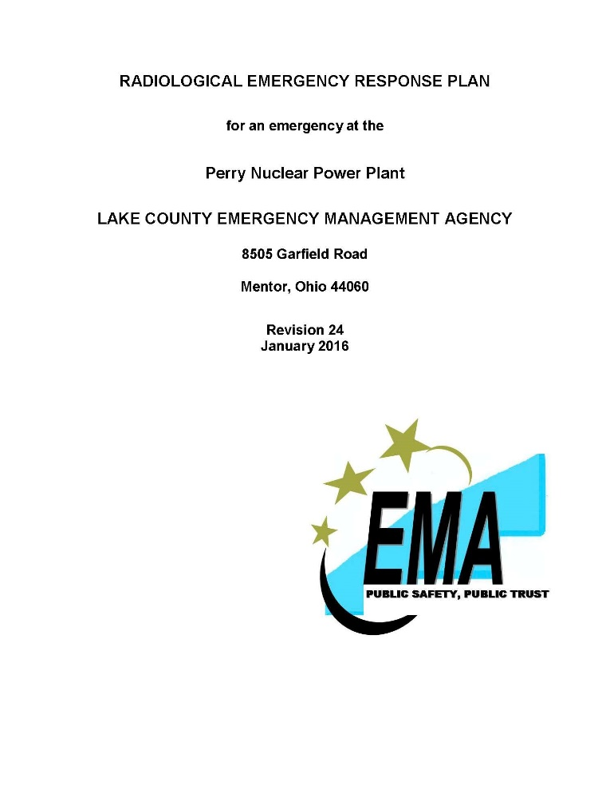
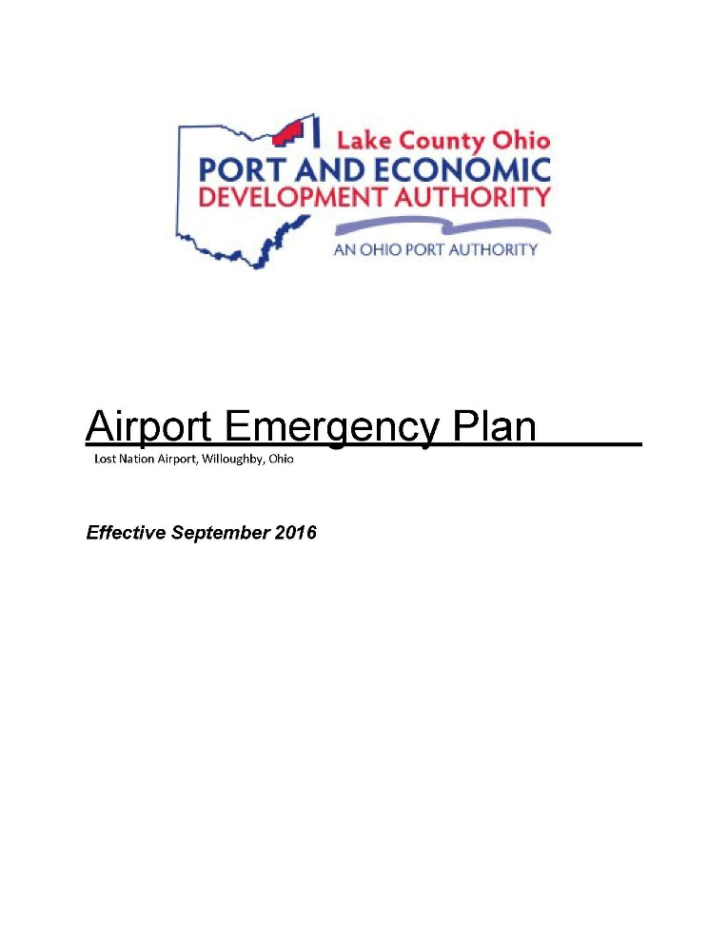
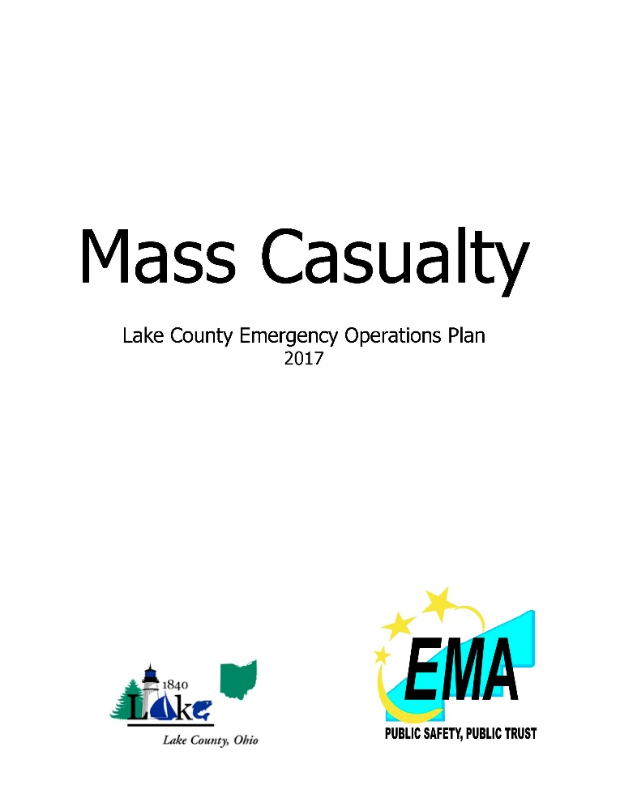

Plans in Lake County

Slide 13
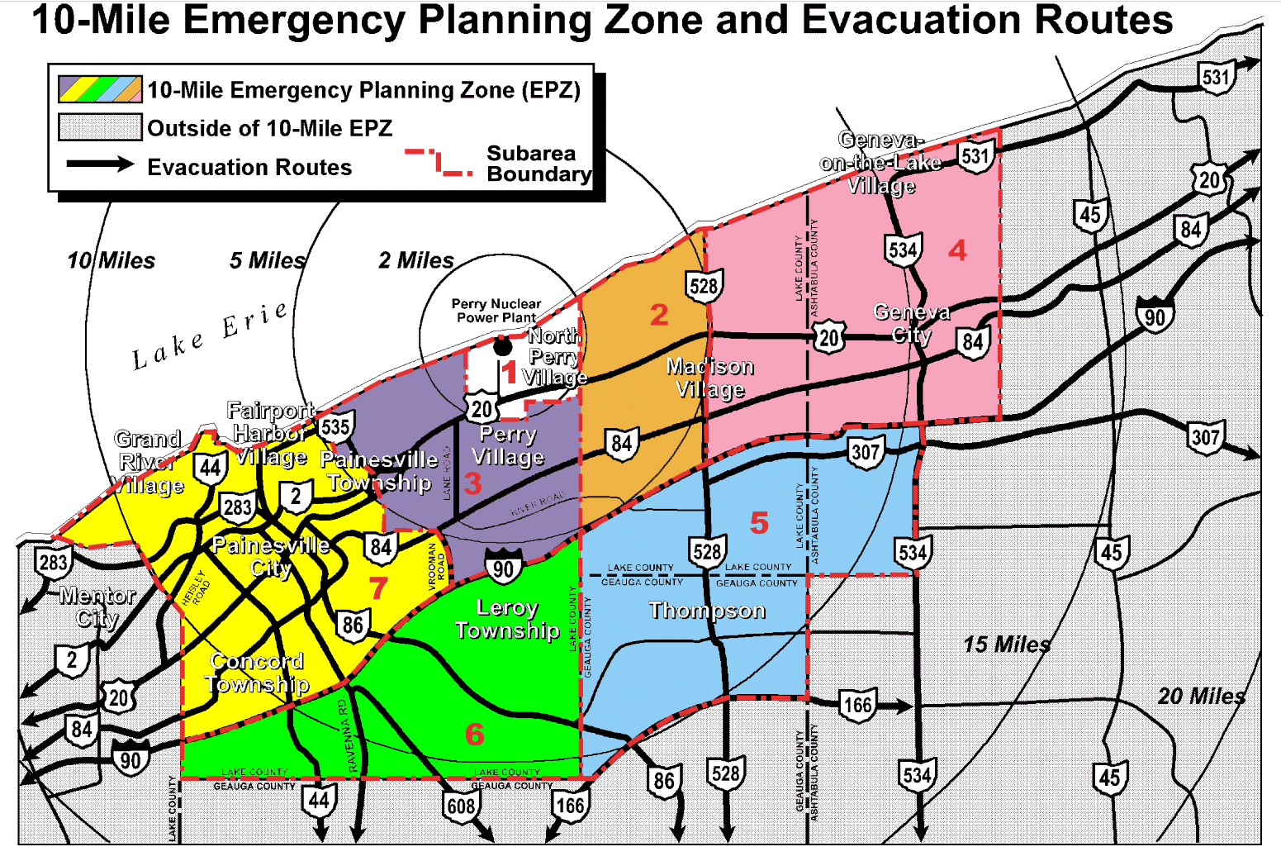
PNPP
10 - Mile
Emergency
Planning
Zone

Slide 14
Emergency Classification System
Unusual Event
Small problem that poses no danger to the public
Alert
Plant could experience decrease in safety. Preparations are being made to handle more serious emergencies (EOC may be activated)
Site Area Emergency
More serious emergency, such as plant equipment needed for safe operations is affected. Radiation will not escape plant boundaries.
General Emergency
Most serious problem. Radiation released may exceed federal limits, Recommendation to shelter or evacuate is made.
Notes:
Alert: JIC activated
Site Area Emergency: schools are being relocated to receiving schools, preschools are closing, parks closing
General Emergency: law enforcement directing traffic from EPZ/ Controlling access to evacuated areas. FD

Slide 15

Where do YOU start?

Slide 16
Common misconceptions
“Most emergencies are short-lived”
The emergency might be acute but the effects can linger over time
“I won’t ever have to deal with an emergency where I live”
Emergencies in Lake County: winter storms, floods, excessive heat/cold, earthquakes (114 from 1885-2022)
“There are a lot of emergencies I just can’t prepare for”
You CAN prepare and use the prep during multiple emergencies
Ex. Items in a “go bag” used for evacuation may also be used in power failures, shelter-in-place, traffic jams etc.
“Preparing takes too much time”
You do not have to prepare all at once, instead take small steps.

Slide 17



Learn the 3 steps to getting prepared
Know the Risks
Make a Plan
Prepare a Kit

Slide 18
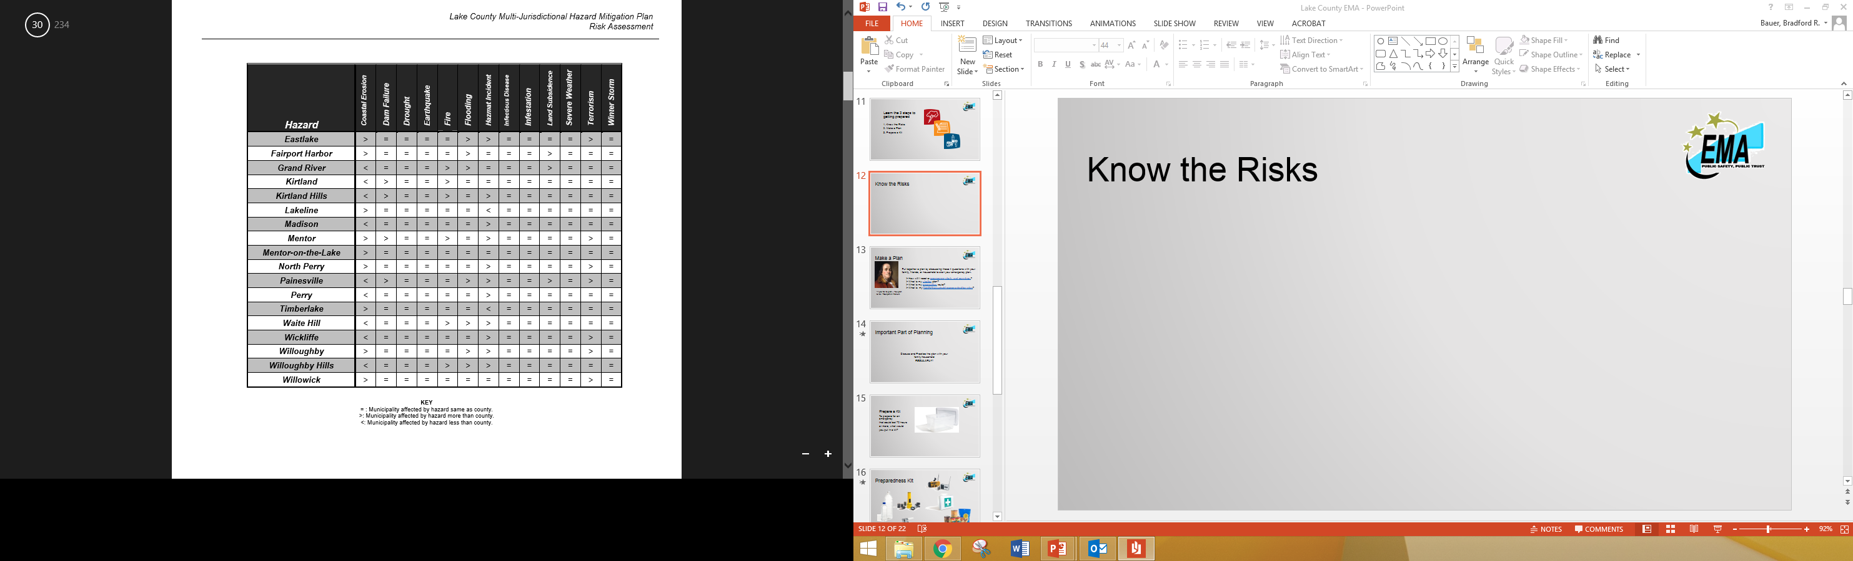
Know the Risks
Table found in Lake County Multi-Jurisdictional Hazard Mitigation Plan

Slide 19

Make a Plan
Put together a plan by discussing these 4 questions with your family, friends, or household to start your emergency plan.
How will I receive emergency alerts and warnings?
What is my shelter plan?
What is my evacuation route?
What is my family/household communication plan?
“If you fail to plan…You plan to fail” –Benjamin Franklin

Slide 20
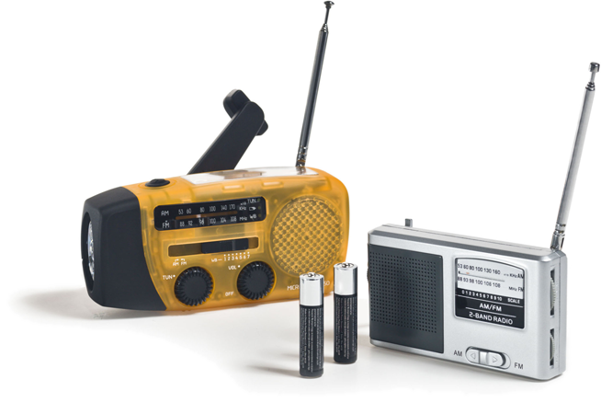

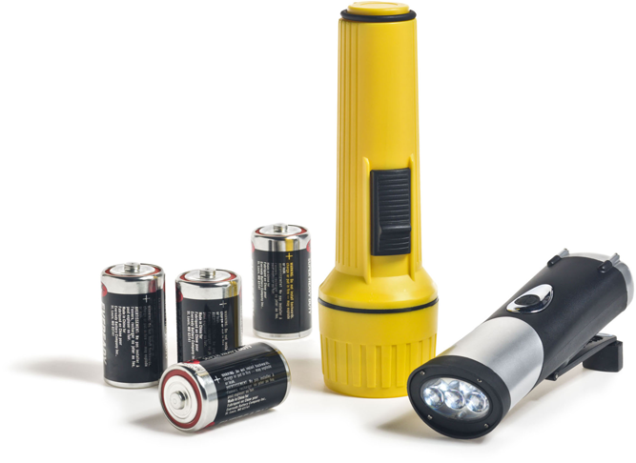
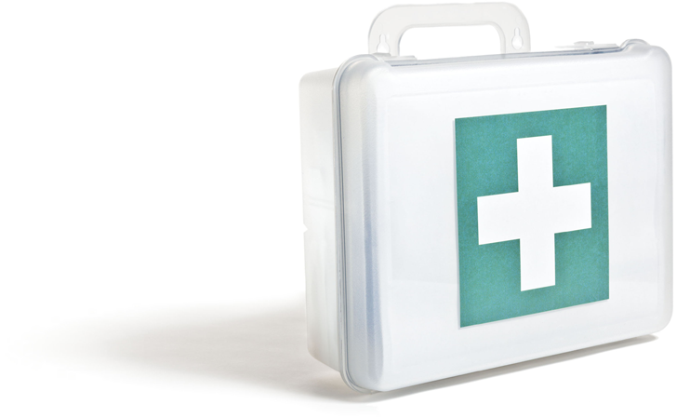

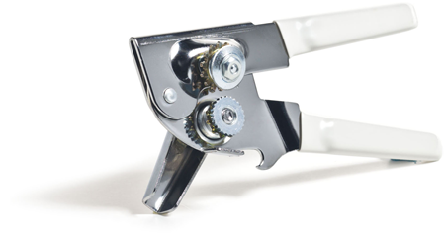
Prepare a Kit

Slide 21
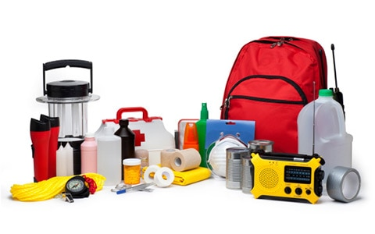
In order to prepare for an emergency that could last 72 hours or more, what would you put in your kit?

Slide 22
List of things to include
Water
Cups
Food
Manual Can opener
Blanket
Flashlight w/ Batteries
Cash/Checks/Debit & Credit Card
Cell Phone w/ Charger & Battery Back up
Extra Clothing
Family Contacts
Family Documents
First Aid Kit
Matches
Pen & Paper
Prescriptions/Medications
Toothbrush/Toothpaste
Glasses (or spare pair)
Towelettes
Towels
Pet or Baby supplies
Emergency Plan
Local utility emergency phone #’s

Slide 23
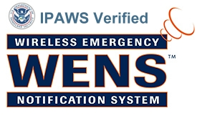
Wireless Emergency Notification System
Reverse 911 system that alerts residents and businesses with automated voice calls, emails and/or text messages.
Conditions that could require use of the WENS Alert
Potential for serious risk to life and property
Notification could aid in the apprehension of a criminal suspect
Notification could aid in the safe return of a child or elderly patient

Slide 24


Slide 25

How to sign up:
Enter:
https://entry.inspironlogistics.com/lake_oh/wens.cfm
Or
www.lakeohioalert.com

Slide 26


